Slide 1

Pioneering Outcomes in AI and Game-Based Learning for Education
Dr. Papia Bawa, Ph.d.
Notes:
---
This presentation delves into the multidimensional aspects of research, focusing on performance, affect, and sustainability. We will explore personal motivations for research, review technology-focused and educational issue-focused studies, and examine the implications for performance, affective outcomes, and sustainability in various educational contexts.

Slide 2

Agenda Items
Inspiration, Interests and Scope
Research on Innovative Instructional Technologies and Design
Active/Ongoing Research Projects

Slide 3

Goals That Drive My Research
Interdisciplinary and/or multidisciplinary
Helping teachers and faculty adopt technologies easily
Collaborative across departments and peers
Inclusive of student participation wherever possible
Intersection of Technological, Pedagogical and Psychological impacts
Being prepared for the present and future: Transformational and Disruptive Technologies

Slide 4
My Research Framework Model: SPA (Sustainability, Performance, Affect)
Importance of Performance
Focusing on performance measurement is crucial for evaluating the effectiveness of educational methods and practices. – Effectiveness, efficiency, productivity, or learning outcomes.
Role of Affect
Understanding the affective domain enhances learning experiences and emotional engagement in educational settings. – Emotional, cognitive, or psychological experiences that influence or are influenced by sustainability and performance.
Sustainability in Research
Integrating sustainability into research frameworks ensures that outcomes contribute positively to future educational practices and society. – Environmental, social, and economic sustainability in organizational, educational, or technological contexts..

Slide 5

Innovative Learning Technologies I Examine
Digital Games
Gamification Tools
Extended Realities (XR)
Artificial Intelligence (AI)

Slide 6

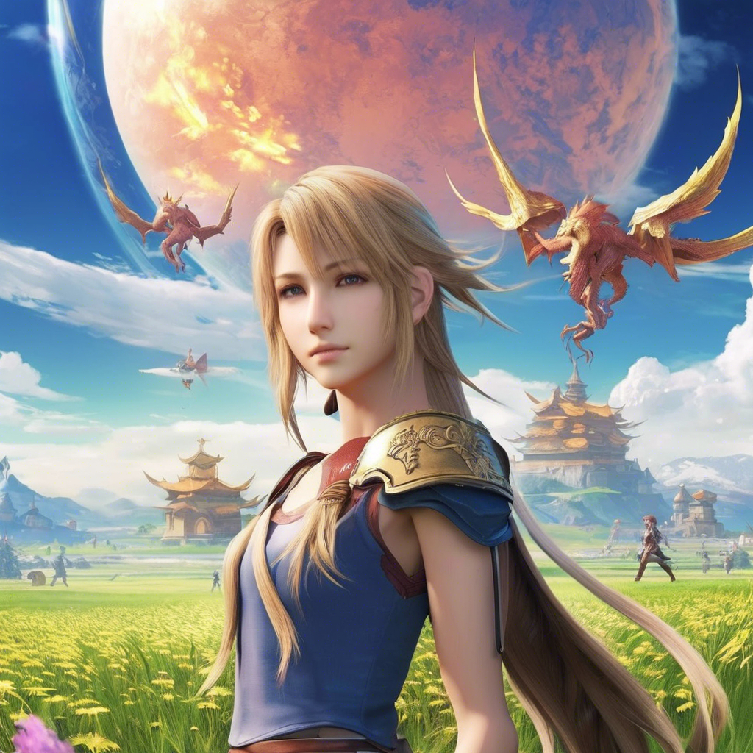
The Birth of a Dissertation

Slide 7

Unique Contributions of My GBL Research

Slide 8
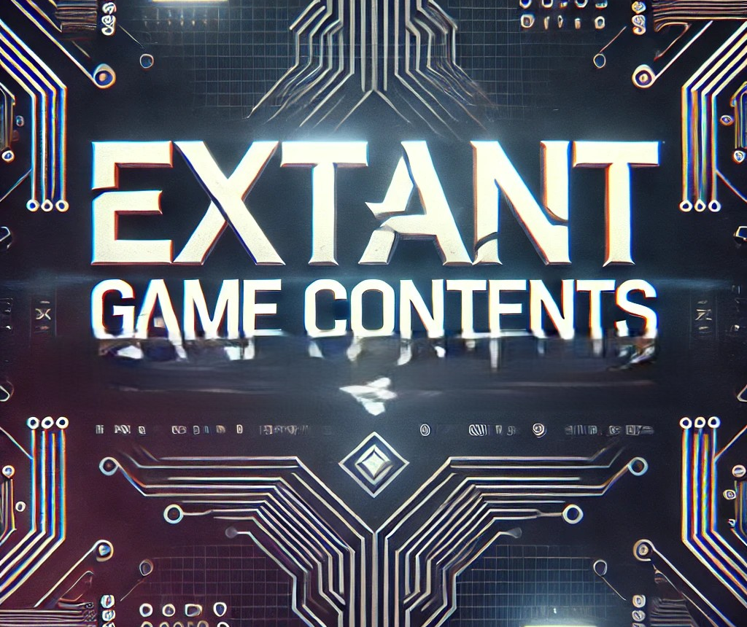
Game Content Theory (GCT) and Game Content Instructional Model (GCIM)
Exploring the value of extant game contents in educational contexts
Notes:
---
This presentation explores Game Content Theory (GCT) and its significant influence on learning and engagement within educational settings. We will discuss the core principles of GCT, research findings, and practical applications for educators.

Slide 9

Core Premise of GCT
Game Content Theory (GCT) and Game Content Instructional Model (GCIM) is an ongoing project that has already completed 9 years and has 14 studies to back up the premise, principles and model. My textbook on GCT and GCIM is in the works and should be published soon.
GCT posits that students’ engagement and learning outcomes can be significantly enhanced by incorporating game-related extant contents into educational settings.
It suggests that students and faculty/teachers do not necessarily need to play games to benefit from them; rather, interacting with game content—such as wikis, blogs, tutorials, and lore—can be just as effective in fostering critical thinking and engagement.
The theory highlights student choice, game selection flexibility, and integration of game-based resources as key drivers of learning success.

Slide 10

My Dissertation Presentation Site
The GCT concept was developed during my dissertation studies.

Slide 11
Post Dissertation Studies and Training
Data from students who participated in courses that used the MMO curriculum faculty trainees had designed indicated a statistically significant improvement in
performance outcomes and application of critical thinking to problem solving, using a
combination of inferential analysis such as Odds Ratio, Cohens d, and ANOVA. Data
indicated that it helped weak performing students raise their scores, and did not
impede the high achievers.

Slide 12
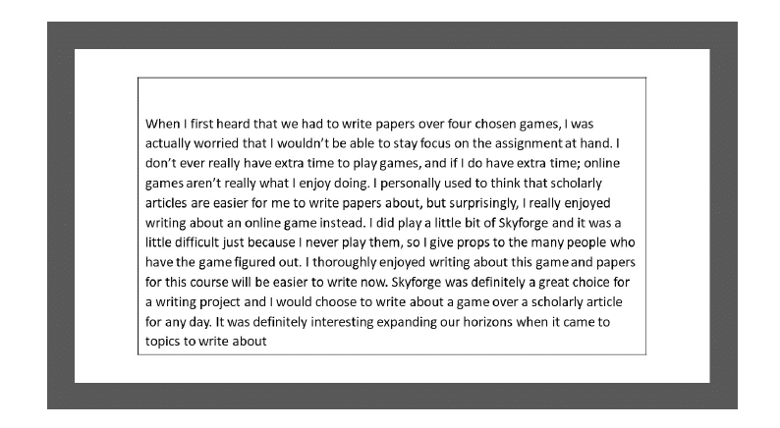
Participant Testimonials

Slide 13

Participant Testimonials

Slide 14
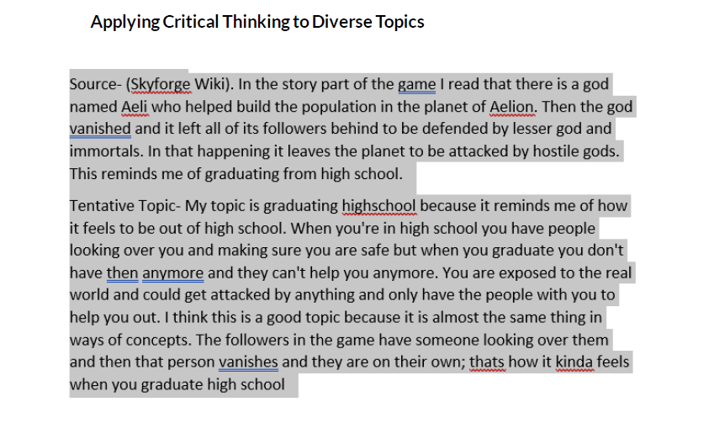
Participant Testimonials

Slide 15
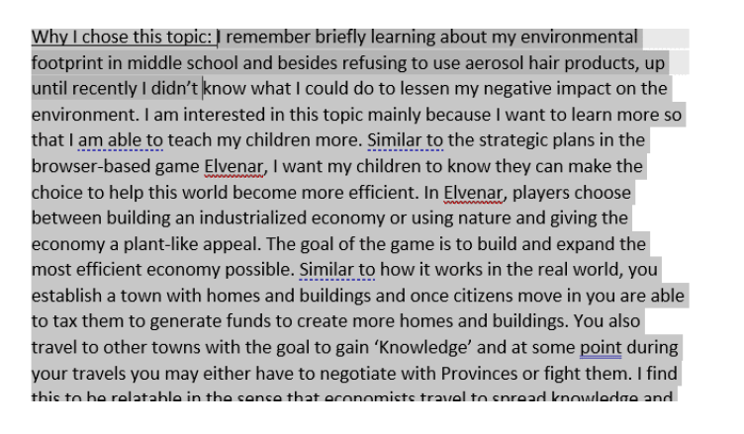
Participant Testimonials

Slide 16

Participant Testimonials

Slide 17
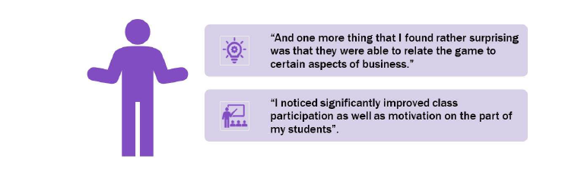
Participant Testimonials

Slide 18

Core Principles of Game Content Theory (GCT)
1. Distinguishing Motivation From Engagement
While motivation is a transitory or transient reaction happening in the moment, without augmentation it cannot be sustained or transformed into engagement. Engagement is motivation that is sustainable outside of a specific setting and permeable from one setting to another.
2. Game Extant Content as an Engagement Tool
Just like playing the games, game related extant contents (guides, videos, blogs) also allow students and faculty/teachers to be motivated enough to warrant engagement with their learning beyond the confines of a classroom environment.
3. Preferences Drive Engagement
Offering students preferences of game selection and use boosts involvement and achievement by enabling them to engage with material that resonates with their personal interests and preferred learning approaches.
4. Reduced Adjustments
Although the choice of games should correspond with curriculum objectives, significant adjustments to align games with specific subjects should be generally avoided. The contents of the games are naturally diverse and suitable for various academic fields.

Slide 19

Examples of Extant Game Contents
Elvenar Wiki
Elvenar Marine Marvels Wiki
Elvenar YouTube Channel
Elvenar Walkthrough
Elvenar Guide
Elvenar Forum
Elvenar Books and eGuides

Slide 20

Barriers that GCT is breaking
✅ Breaks the need for expensive gaming hardware and software – Since students can engage with game-related content (wikis, blogs, YouTube tutorials, etc.) rather than playing the game itself, there is no requirement for high-end PCs, gaming consoles, or paid game licenses.
✅ Supports broad curriculum adoption – Because the focus is on game-related content rather than gaming skills, GCT can be easily applied across multiple disciplines without requiring major curriculum redesigns.
✅ Minimizes the need for instructors to be gaming experts – Educators don’t need to master game mechanics or gameplay to integrate game content effectively. They can focus on using game-based resources as supplementary learning materials.
✅ Simplifies curriculum alignment – Instead of extensive modifications to match games with learning outcomes, instructors can leverage existing game content (such as in-game economies, narratives, and strategic decision-making) to fit their subjects.

Slide 21

Key Steps of the GCT Process

Slide 22
Step 1: Identify Relevant Games and Content
Select games based on key student preference factors, such as social features, modding capabilities, and immersive storytelling.
Ensure that chosen games align with institutional and curricular requirements (e.g., free-to-play, online accessibility).
Consider genres that support learning without requiring complex gameplay (e.g., strategy, simulation, role-playing).

Slide 23
Step 2: Provide Flexible Engagement Options
Allow students to choose how they interact with game-based learning materials: Engaging in actual gameplay, or. Exploring game-related content (wikis, blogs, lore, videos, discussion forums), or. Combining both approaches to enhance understanding.
Ensure that students have multiple games to choose from.

Slide 24
Step 3: Incorporate Game Content into Assessments
Design assignments that integrate game-based learning, such as:
Persuasive essays based on game themes.
Business case studies drawn from economic simulation games.
Research projects analyzing game narratives and mechanics.
Use rubrics that prioritize critical thinking over structural formalities (e.g., APA/MLA citations).

Slide 25
Step 4: Measure Learning Outcomes
Assess student performance through multiple instruments, such as:
Essays and research papers.
Reflection journals on game-related learning experiences.
Peer discussions and collaborative problem-solving tasks.
Semester long, iterative projects

Slide 26
Step 5: Evaluate and Iterate
Collect student feedback on their learning experiences with game content.
Refine game selection and instructional strategies based on engagement levels and performance data if needed.
Expand the use of game-based resources to additional disciplines where applicable.

Slide 27
Selected Studies
Study: Bawa, P., Lee Watson, S., & Watson, W. (2018). Motivation is a Game: Massively multiplayer online games as agents of Motivation in higher education. Computers & Education. doi:10.1016/j.compedu.2018.05.004
In her 2021 article published in Computers and Education Open, Dr. Papia Bawa explored the perceptions of administrators and faculty regarding the integration of Massively Multiplayer Online Games (MMOGs) into higher education curricula. The study revealed that non-gameplay elements, such as game-related content from wikis and tutorials, can be as motivational as actual gameplay, suggesting a paradigm shift in educational strategies.
Study: Bawa, P. (2020). Game on! Investigating Digital Game-Based versus Gamified Learning in Higher Education. International Journal of Game-Based Learning, 10(3), 16-46. https://doi.org/10.4018/ijgbl.2020070102
In this study I compared the effectiveness of digital game-based learning (DGBL) and gamified learning in higher education. The research found that both digital educational games (DEGs) and massively multiplayer online games (MMOs) can enhance student engagement and learning outcomes compared to traditional teaching methods.

Slide 28
Study: Bawa, P. (2021). What do they think and why it matters? Views of administrators and faculty on the use of massively multiplayer online games for learning. Computers and Education Open, 100034. https://doi.org/10.1016/j.caeo.2021.100034
In this article I explored the perceptions of administrators and faculty regarding the integration of Massively Multiplayer Online Games (MMOGs) into higher education curricula. This study also revealed that non-gameplay elements, such as game-related content from wikis and tutorials, can be as motivational as actual gameplay, suggesting a paradigm shift in educational strategies. Administrators were significantly more open to allow use of such games if the faculty and students were not required to play the games.
Study: Bawa, P. (2022). Why Games? Use of Massively Multiplayer Online Games in English and Business Courses in Higher Education – Administrator and Faculty Perceptions. International Journal of Game-Based Learning, 12(1), 1-12. https://doi.org/10.4018/ijgbl.294011
The study found that both administrators and faculty recognized the potential benefits of Massively Multiplayer Online Games (MMOGs) for fostering student engagement, collaboration, and skill development in Business and English courses. However, concerns were raised about implementation challenges, including institutional resistance, resource constraints, and faculty workload. The study suggested that while MMOGs can enhance learning, their successful integration requires institutional support, professional development, and clear alignment with course objectives.

Slide 29

Extended Realities (XR) and Artificial Intelligence (AI)
[VGAI & GPT]

Slide 30

What is Video Game AI (VG AI) vs Generative AI
Video game AI: (Artificial Intelligence) refers to the algorithms and systems used to create intelligent behavior in non-player characters (NPCs), enemies, and other in-game elements.
Unlike generative AI, which aims for human-like reasoning and learning, video game AI is usually designed to create engaging, responsive, and sometimes unpredictable gameplay experiences.
Generative AI: Primarily focuses on creating new content (such as text, images, music, etc.) based on input data. It generates novel outputs rather than following predefined rules or patterns.

Slide 31
What is Video Game AI (VG AI) vs Generative AI
VG AI
Generative AI
(Purpose)Created to generate novel content (e.g., text, images, music) based on input data.
(Creation) Generates new content with minimal interactive response, based on learned data.
(Techniques) Relies on deep learning models such as transformers, Generative Adversarial Network or Variational Autoencoder or VAEs.
(Purpose) Designed to enhance interactivity and simulate NPC behavior in games.
(Interaction) Reacts to player actions in real-time, aiming for realistic gameplay experiences.
(Techniques) Uses techniques like finite state machines, pathfinding algorithms (A*), behavior trees.

Slide 32
How Similar is Video Game AI (VG AI) to Generative AI
Learning and Adaptation: Both can "learn" or adapt to improve performance.
Pattern Recognition: Both identify and utilize patterns. Video Game AI uses predefined patterns, and Generative AI creates new ones from data.
Optimization: Both aim for better outcomes: Game AI optimizes NPC behavior, while Generative AI focuses on improving content quality.

Slide 33

Unique contributions of my AI and XR research

Slide 34
The Theories of Bio Virtualization and Phantom Stimulus
Bio-Virtualization is a theory that explores how digital interactions—especially interfacing with video games AI—can extend cognitive processing beyond direct engagement, leading to delayed memory recall, sensory experiences, and synaptic adaptation without the need for external hardware.
This phenomenon suggests that human cognition can interface with non-human digital stimuli in ways that influence memory, perception, and even dream states, shaping how information is processed across time and space.
“Definition: … “hyper cognition and memory reproduction through synaptic interfacing between a human receptor and a non-human stimulus such as video games.” (Bawa, 2023).

Slide 35

The phantom stimulus is a term I am using to identify post video game sensations. Phantom Stimulus refers to the phenomenon in which individuals experience lingering sensory, cognitive, or emotional effects from a virtual or digital environment after disengaging from it. This can include perceiving sensations, visual elements, or emotions from a video game or simulation in real-world settings, even when no direct stimulus is present.
Prolonged interaction with a digital or gaming environment can induce post-play sensory and cognitive effects. These effects may manifest as visual, auditory, tactile or Feeling physical sensations related to in-game actions, and Cognitive/Emotional – Experiencing thought patterns or emotions tied to gameplay outside the game environment.
This phenomenon suggests that video games and AI-driven experiences can shape perception and memory beyond active engagement, offering new insights into learning, memory formation, and digital immersion.

Slide 36
Barriers This Research Breaks
✅ Bridging Neuroscience and Gaming – Traditional gaming studies focus on behavior; fNIR provides direct biological evidence of how games shape cognition.
✅ Personalized AI Training Models – Insights from fNIR can optimize AI-driven learning experiences, tailoring content to individual emotional and cognitive responses.
✅ Overcoming Skepticism on the use of Generative AIs and Game-Based Learning – Empirical data can validate video games and GPTs as serious cognitive and learning tools, reducing resistance in academic and corporate training settings.
✅ Non-Intrusive Cognitive Analysis – Unlike fMRI, fNIR is portable, cost-effective, and allows natural movement, making large-scale cognitive studies on gaming more feasible.

Slide 37
Selected Studies
Study: I Feel You: Emotional Processing Through Gameplay AI and fNIRs (Bawa, 2025) (In Review)
Gameplay can evoke a range of emotions, influencing how players process feelings in their dreams.
The interplay between gaming and dreams may enhance psychological well-being by providing coping mechanisms.
Study: Bawa, A., & Bawa, P. (2023). Faculty perceptions on using virtual reality: Strengths, weaknesses, and recommendations. SN Computer Science, 4(5). https://doi.org/10.1007/s42979-023-02055-x
Virtual reality enhances engagement and interactivity in the classroom, providing immersive learning experiences for students. Challenges include high costs and the need for adequate training for faculty to effectively implement VR technology. Actionable recommendations involve providing training and resources for faculty to maximize the potential of virtual reality in their teaching.

Slide 38
Selected Studies
Study: Bawa, P. (2023). Dreams and Games: Exploring Memory Retention Through Dreams Associated with Video Gameplay. Journal of Research Initiatives, 7 (2), Article 6. https://digitalcommons.uncfsu.edu/jri/vol7/iss2/6
This study examined the possible impact of video game activity related to interaction with game AI on cognition and long-term memorization through recall and visualization in dreams. The results of this study indicate that interfacing with video games allowed the players to evoke vivid and coherent memories of the game play which were manifested within their dreams.
Study: Leveraging Artificial Intelligence for Transformative Education: Challenges and Recommendations. (Bawa, 2025). (In Review)
This study examined the applications and challenges of multiple AI Generative tools for learning, based on the assumption that AI fosters self-directed learning and enhances engagement through adaptive pathways. AI's role in accessibility, from personalized learning tools to assistive technologies, underscores its potential to bridge educational gaps (Gabriel, 2024). However, biases in data, high costs, and technological limitations pose significant barriers.
This study concludes with the AI10 model that proposes 10 key steps to undertake for future AI research in education.

Slide 39

Ongoing Research

Slide 40

Project 1: Video Games, XR and Cognitive Fallouts
The study uses fNIR devices to investigate the sustained effect of video game playing and exposure to XR environments on cognition and physical stimuli, including phantom stimuli (feeling things/realities in the real world after emerging from the game world).
The machine can be used to map the cognition and brain activity over a time stream ranging from when the interfacing takes place and then periods of 12, 24, 48 and 70 hours after.

Slide 41

Project 2: The inclusive play: Harnessing video games and Generative AI to aid cultural awareness
Project seeks to investigate multiple facets of game-based AI and simulation environments to augment cultural awareness.
This project is also tied to cancer community support initiatives

Slide 42

Generative AI Analysis and Application
This study series aims to examine how practitioners can best use Generative AI tools, focusing on their effectiveness, ethical challenges, and strategies for responsible implementation.
Key Areas of Investigation
Practical Use of Generative AI in Professional Settings
  Identifying best practices for integrating AI into workflows.
  Evaluating AI-driven efficiency improvements and decision-making support.
  Case studies on AI implementation in education, corporate training, and design.

Slide 43

Front End AI Analysis and Application
Generative AI and Workforce Evolution
  The impact of AI on job roles and required skills.
  Training professionals to adapt to AI-enhanced environments.
  Exploring AI as a creative and cognitive augmentation tool rather than a replacement.
Ethical Challenges in Generative AI Adoption
Bias and Fairness, Data Privacy, General Data Protection Regulation (GDPR)
Intellectual Property and addressing plagiarism risks and ownership of AI-generated content.
This series will contribute to Generative AI literacy, ethical awareness, and strategic implementation across industries, empowering practitioners to leverage AI effectively and responsibly.

Slide 44

Thank you for watching the presentation

